Slide 1


Unit 7

Slide 2
Keynote
Read bio Janet Echelman (p74)
‘huge, flowing objects that respond to environmental forces’ = ?

Slide 3

Prior to watching (p75)
Ex 2 Key words: Match
Ex 3a Listening

Slide 4

Key 3a
Fulbright
= a scholarship offered by the Fulbright Commission
given to a range of people, e.g. artists and academics
most prestigious international exchange programme with the US
35 Belgians per year

Slide 5
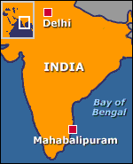
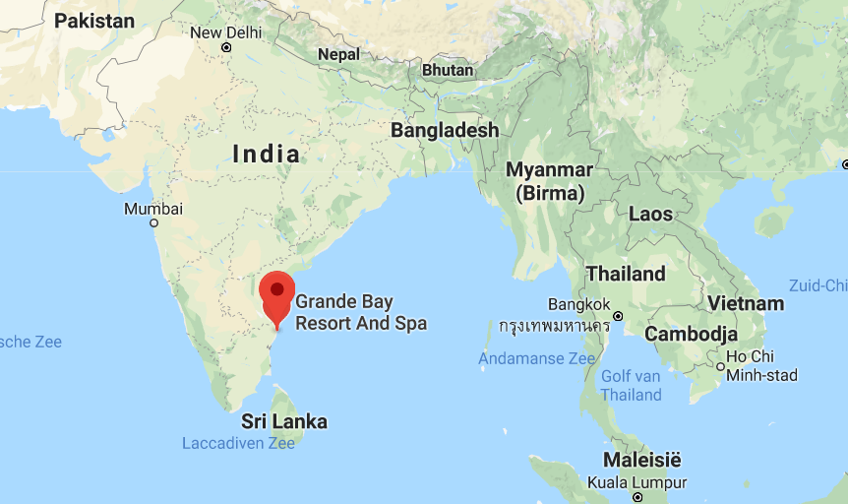
Mahabalipuram
= famous ancient seaport town in India

Slide 6
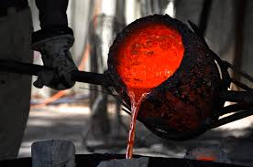
Bronze casting

Slide 7
7.1 Taking imagination seriously
(Please use your own DVD)

Slide 8
7.1
Ex 1: True or False?
Ex 3: Correct six errors

Slide 9
Key Ex 1 True/False
1 T
2 T
3 F
4 T
5 T
6 F

Slide 10
Key Ex 2 Q&A (@home)
1. She taught herself after being rejected by 7 art colleges.
2. sculpture + fishing
3. local fishermen / image of herself
4. Lithuanian lace makers
5. It had to be a permanent structure.
6. an industrial fishnet factory

Slide 11
Key Ex 3 Six errors
smoke: mist
above: under
photographs: data
longer: shorter
more delicate: stronger
trees: buildings

Slide 12
Key Ex 4 (@home)
It hasn’t been built because there is no funding available.
Traditional craft forms and hi-tech materials and engineering
They rediscovered wonder while lying under it and looking up.

Slide 13

@home (voc in context)

Slide 14
7.3 In my mind’s eye
Read text p81: The power of visualization
Ex 2 p80: Match the summaries (1-5) with the paragraphs (A-E).

Slide 15
Key Ex 2 p80
1B
2A
3E
4C
5D

Slide 16
Ex 3: Choose the correct options.
(Ex 4: Q&A)
Ex 5: Expressions with ‘mind’
Ex 6: Match
Ex 7: pair work

Slide 17
Consider this…
Subject line: problem ☹
Dear Shoefs
Can I do the test tomorow? I have to take my drivers lisense test ☺.
CU
Vlaeyen Cedric
P.S. Hope I pass. Its the tird time I take it. LOL.

Slide 18
Syllabus p138-139
Formal vs. Informal writing
Features?

Slide 19
2. Register p140
= variety of language
used in a particular situation
!!Not black or white, but a SPECTRUM

Slide 20

Ask yourself 4 questions when writing p140
Who am I writing to?
What is our relationship?
Why am I writing?
What action do I expect?
= audience design

Slide 21
Exercises
Ex 1 p141 informal ➔ formal
Ex 2 p142 formal ➔ informal
Ex 3 p143 formal ➔ informal

Slide 22
3. Useful expressions and voc p144
Salutations
Dear Sir or Madam(,)
Dear Mr Bond(,)
Dear Ms Moneypenny(,)
Complimentary closes
Yours faithfully(,)
Yours sincerely(,)

Slide 23
NEVER
only ‘Dear’
!!!

Slide 24
Opening and closing p145
Match the beginnings (1-8)
with the endings (a-h).

Slide 25
Key phrases p146-147
Ex 5
Choose a subject line.
1
Ex 6 Complete the table (using the underlined phrases).
2

Slide 26
4. Addresses p148
@home

Slide 27
5. Making enquiries p149-150
Ex 1
Fill in the gap with the appropriate word.
Ex 2
Complete.

Slide 28
6. Your turn to write! (formal) p151
Pair up
Try mail A p151
Send it in by mail. (attach a separate wordfile!)

Slide 29
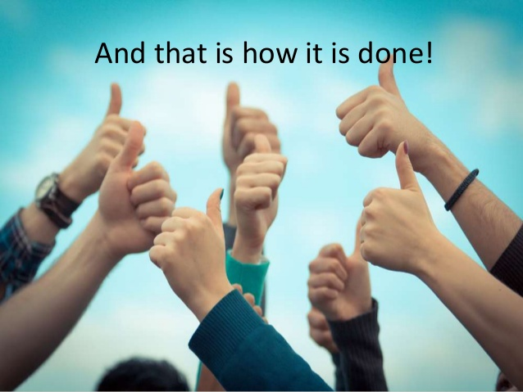
Dear Ms Schoefs
Enclosed you will find today’s assignment.
Yours sincerely
FN-LN
(class)

Slide 31
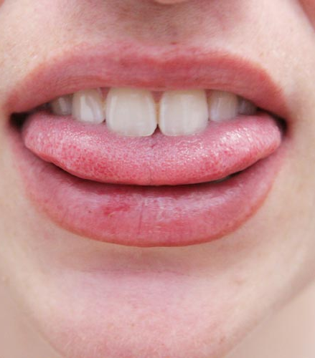
Pronunciation syllabus p194
Use some online help:
http://www.macmillandictionary.com
British vs. American pronunciation!

Slide 32
Spelling for beginners
in ACE (with key)

Slide 33
Punctuation Syllabus p132
Complete this sentence with the missing punctuation:
A woman without her man is nothing.

Slide 34
Singular nouns + ‘s
Have you seen the dog’s bone?
Singular nouns ending in –s + ‘s
The actress’s role was very difficult.
Plural nouns ending in –s + ‘
I went to my friends’ party.
Plural nouns NOT ending in –s + ‘s
The men’s toilet was disgusting.
As part of a phrase cfr. rules above
I had to give two weeks’ notice I was leaving.

Slide 35
Oxford comma: compare
I love my parents, Lady Gaga and Humpty Dumpty.
I love my parents, Lady Gaga, and Humpty Dumpty.

Slide 36
Comma splice
It is nearly half past five, we cannot reach town before dark.
= WRONG
VERY WRONG!!!!!!
It is nearly half past five; we cannot reach town before dark.
It is nearly half past five. We cannot reach town before dark.

Slide 38
PE4 (Deadline 28/04/2018)
Teams of 4 or 5
Discussion topics
Skype for business
NO CLASS (week 9)

Slide 39
7.2 I was miles away! Keynote p78
Do you sometimes daydream? Is it useful?
Infograph (food for thought)
Ex 4a + 5 p79 The power of daydreaming

Slide 40
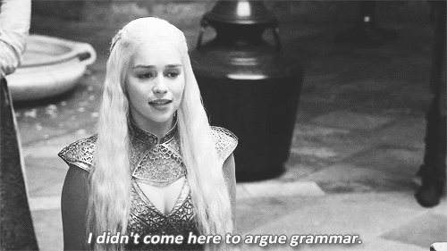
Tenses
Simple Present
Present Continuous
Simple Past
Past Continuous
Simple Present Perfect
Present Perfect Continuous
Simple Past Perfect
Past Perfect Continuous
Simple Future
Future Continuous

Slide 41
Pop quiz
Yesterday a bird …………………………….. (to fly) straight into the window.
He ………………………………………… (to hang) the sheet on the washing line and went inside to watch TV.
The sun …………………………… (only just /to rise) when he jumped out of bed.
He ………………………………………. (to lie) perfectly still when she came in.
When she looked in the mirror, she realized she ………………………………… (to tear) her dress while climbing the fence.
It suddenly ……………………………………… (to strike) me yesterday that he might have been telling the truth.
He said he had cleaned the house, but when I checked I realized he …………………………….…….. (to sweep) everything under the carpet.
I ……………………………… (NOT/to wear) these clothes in ages.
…………………………… (He / ever / to swim) more than 25 metres?
The boy came crying to his mother because his toy boat …..……………… (to sink).

Slide 42
flew
hung
had only just risen
was lying
had torn
struck
had swept
haven’t worn
has he ever swum
had sunk

Slide 43
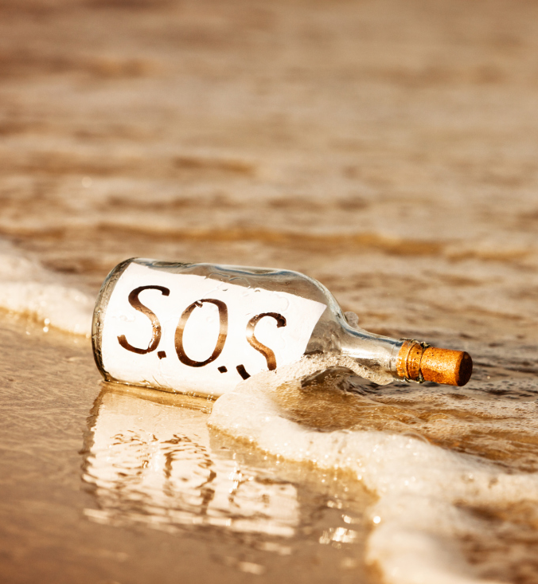
SOME HELP
Complete the list (syll p166)
Present Tenses (p167-168)
Past Tenses (p169-170)
Present Perfect Tenses (p171-172)
Past Perfect Tenses (p173-174)
Future Tenses (p175-177)
Exercises 4+6 Keynote p153

Slide 44
7.4 That doesn’t seem possible p82
Listening
Ex 3: complete (Speculating)
Ex 2: Definitely true/Maybe true
Ex 5: pair work: The World’s Most Mysterious Manuscript

